Slide 1
SOFTENG 306
Task Scheduling Problem
ORMULSOFT
Members: Harpreet, Matthew, Eugene (Team Leader), Shane, Nikhil

Slide 2

Tasks
6 Main Categories:
Planning
Prototyping
Development
Refinement
Testing
Documenting

Slide 3
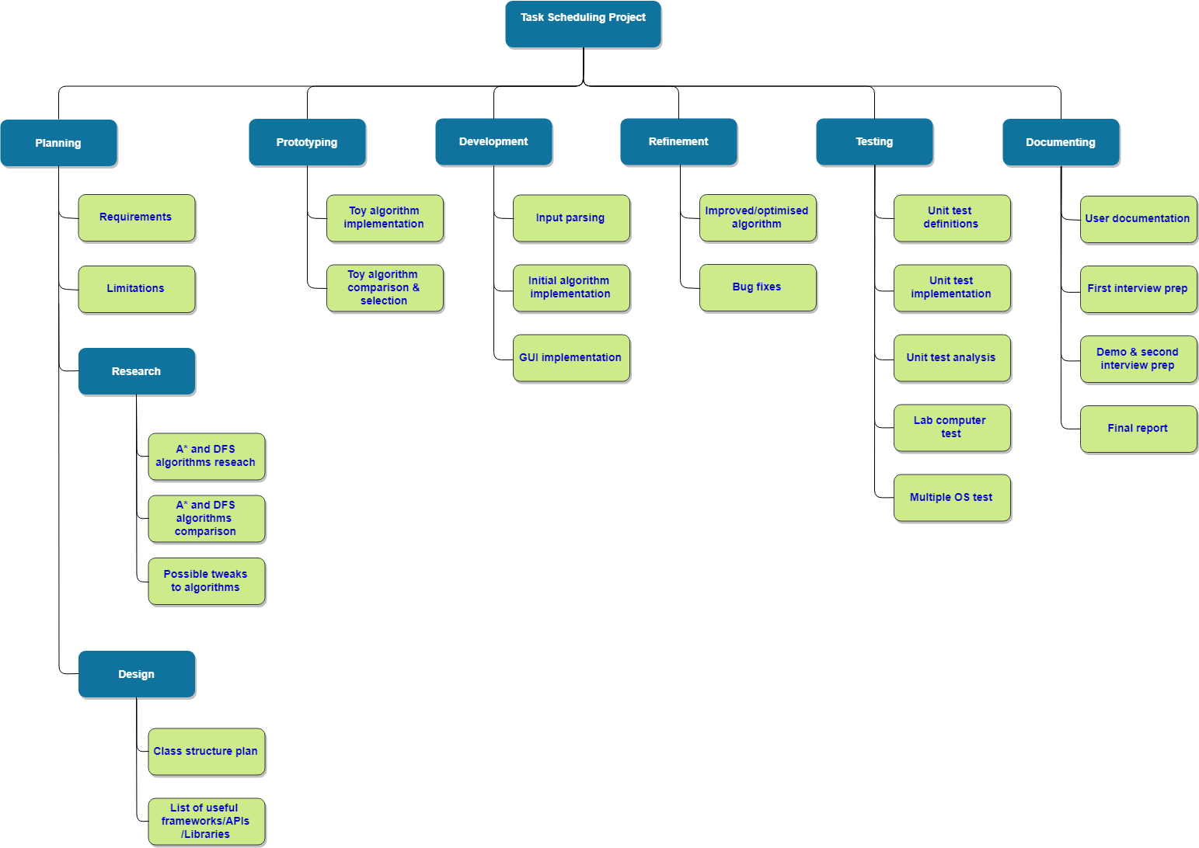
Work Breakdown System

Slide 4
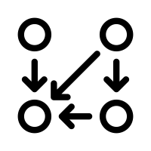
Dependencies
Tasks dependent on other tasks to be finished:
List of useful frameworks/API → Toy implementation
Algorithm research and comparison → Toy implementation
Initial implementation and testing → First interview preparation
Improvement and refinement steps have cyclic dependencies.
Compatibility tests on lab machines have a cyclic dependency with bug fixes.

Slide 5
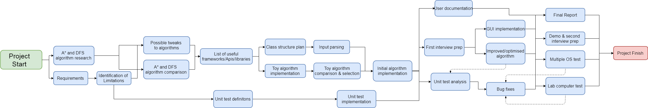
Network Diagram

Slide 6

Time and Work Allocation
Work is split equally and fairly
Allocated according to everyone’s strengths
Allocated with regard to the task’s difficulty
Allocated according to the estimated time taken
Time is allocated according to the milestones and safety
Keep slack time for unplanned things/things going wrong
Tasks are time-managed so that the milestones are achieved comfortably
Interview preparation is also a task, which is allocated sufficient time before both interview phases

Slide 7
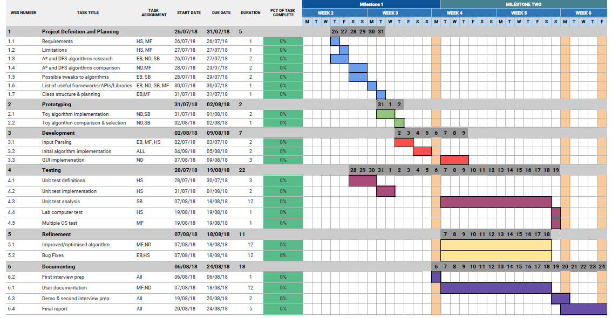
Gantt Chart

Slide 8
Any questions?

